Slide 1
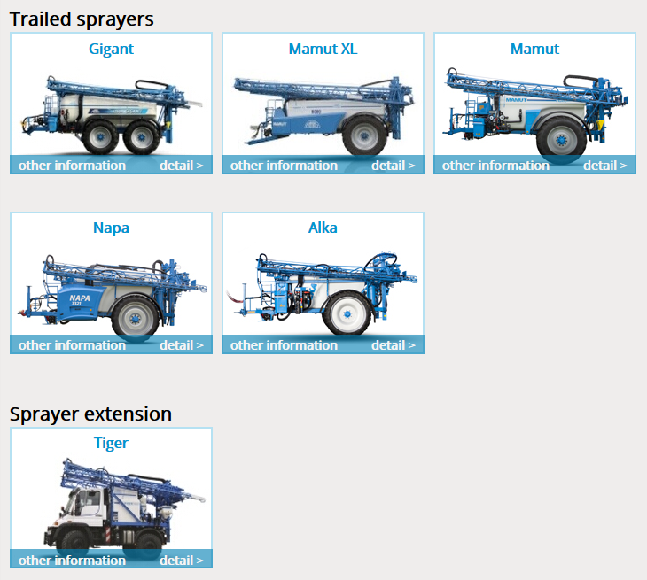
1.1. Choose the machine type

Slide 2
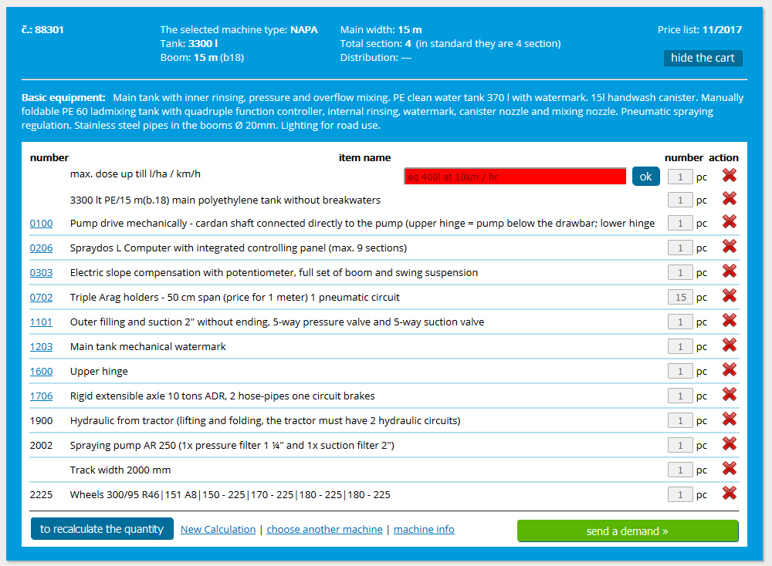
1.2. In the cart is standard equipment

Slide 3
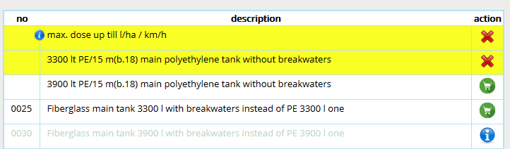
1.3 Selecting items
The possibility of item selection depends on Action column and has four possibilities.
In the Action column is a red cross, whole line is yellow colored and it means, that item is already in the cart.
In the Action column is a green shopping cart icon, it means that this item can be add to the cart.
In the Action column is a blue icon, text is grey, it means that it will be possible add the item to the cart, but it is conditioned by adding some additional item.

Slide 4
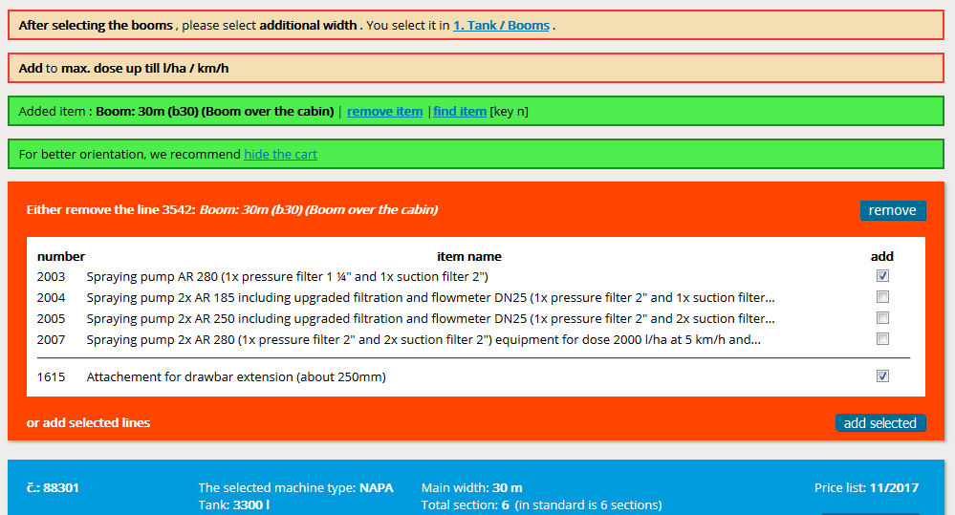
1.4. Warnings
From the beginning during the adding of individual items the configurator points to the necessity of adding some additional items with the help of various warnings.
Orange with weak orange frame points to the necessity of adding or deleting some item or adding some data, e.g. to choose the booms and additional width.
Green points to change of items in cart, new item has the same function, e.g. instead of 3300l tank is chosen 3900l tank.
White with strong orange frame points to necessity to add something to previously chosen item, e.g. if we add bigger tank, we have to choose stronger pump.
You can add and delete items immediately, or wait until they appear in menu and then resolve them.

Slide 5
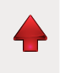
1.5 Move in the configurator
For quick return to the cart use this arrow in right down corner.
If the arrow is red, it points to necessity of adding or changing of something.
If the arrow is blue, everything is OK.

Slide 6
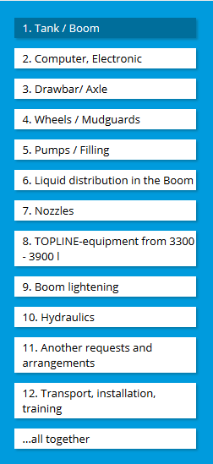
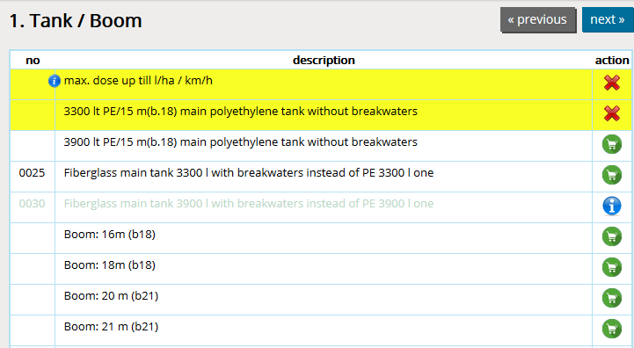
1.6. Menu
In the menu are individual equipment sorted into chapters.
When offer making is the best to go from one to twelve.
The individual chapters are opened by clicking, fast scrolling using numbers 0 to 9 and +; -
If in „no“ column is this sign, there are additional information about the item (e.g. item description or some recommendation, which is necessary to respect).

Slide 7

1.7. Tank/booms – tank selection
Selection of volume and type of main tank

Slide 8
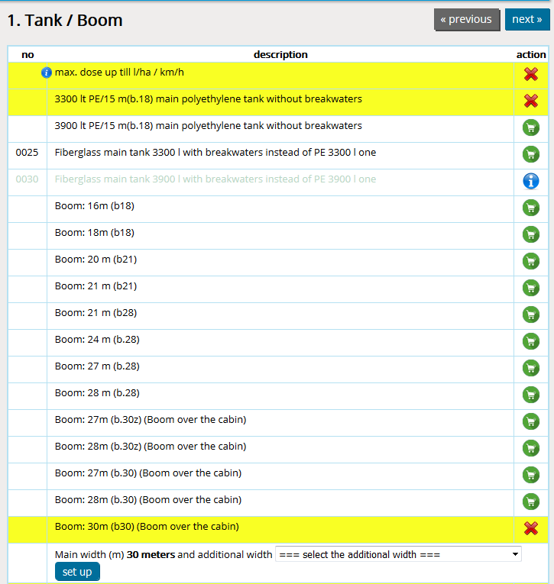
1.8. Tank/booms – booms main width selection
Booms main width selection

Slide 9
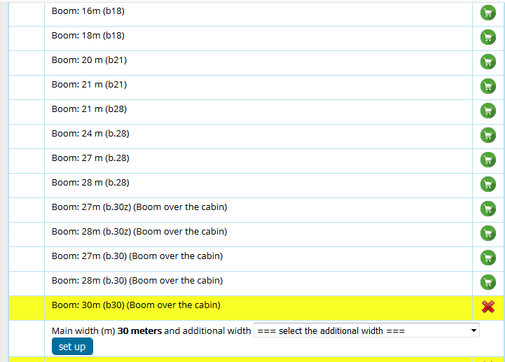
1.9. Tank/booms – booms additional width selection
First use the arrow to expand the list.
Then required to select one of the options.
At last click "set".
If you select the variant where is booms overturning, folding back or hydraulic tilting, you will be notified for necessity to add some of following items: 0307; 0308; 0309; 0310.

Slide 10
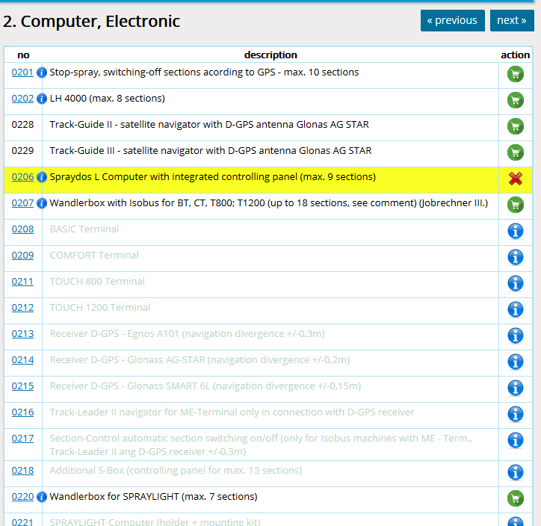
2. Computer/electronics
Computer, GPS, monitor and accessories selection

Slide 11
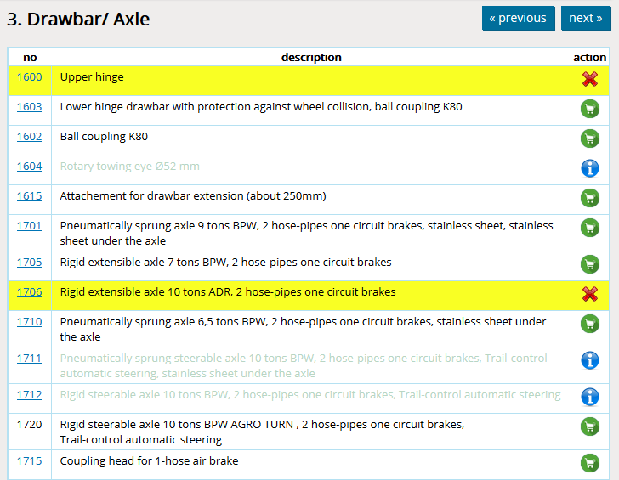
3.Drawbar/axle
Drawbar type, axle type, accessories selection

Slide 12
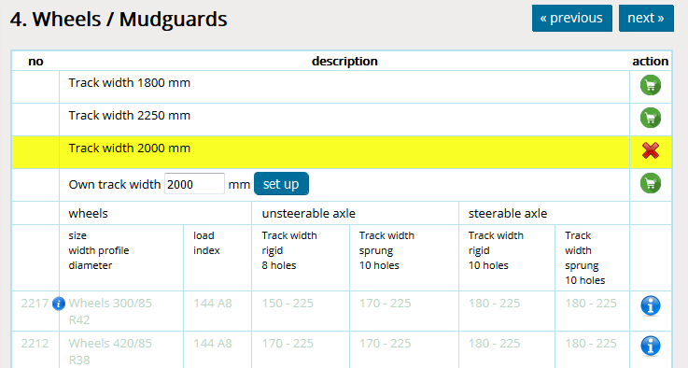
4. Wheels/mudguards
Possibility of choice of preset track widths or own track width.
When choosing the track width is necessary, that its value is not smaller or bigger, than is allowed with this wheel – axle combination.

Slide 13
5. Pumps/filling
Item selection of Pumps/filling equipments.
Don´t forget choose the ending C; B or Fixlock.
Here you can change pump drive or its size.

Slide 14
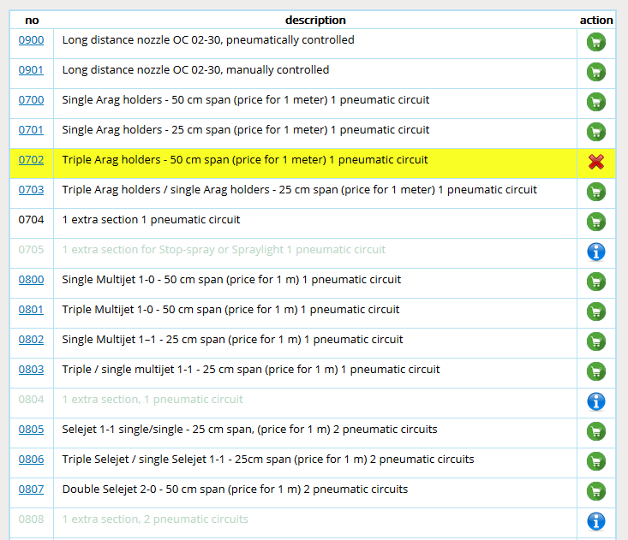
6.1 Liquid distibution in booms - nozzle holders
When choosing nozzle holders is automatically set theirs number according chosen working width.
According chosen nozzle holders is automatically changed also the item „extra section“, you only have to agree.
If is needed the the wandlerbox for more circuits, you will be notified about and is enough to just choose from menu and agree.

Slide 15
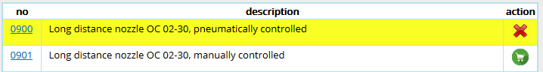
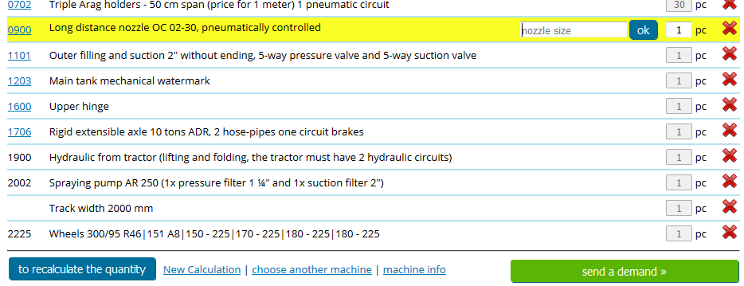
6.2. Liquid distibution in booms - OC holders
After choosing of OC nozzle don´t forget to add its size, number of pcs and click for recalculate the quantity.
If you have only one OC nozzle, write next to its size on which side of booms to mount it.
Before adding OC nozzles (0900 item) pay your attention to information of chosen computer regarding OC nozzles.

Slide 16
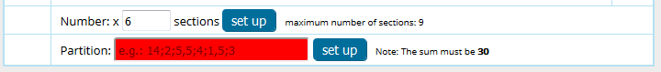
6.3. Liquid distribution in booms – number of sections and their partition
In the box number of sections is information about number of sections for chosen booms.
If you want to have more sections than is preset, so delete the current number and add there your required number, that can´t be bigger than maximal number of sections in the same line, click the „set up“ button and you will find out, how many more sections is necessary to add.
To the partition box add information about the size of each section, the smallest possible size is 0,5 m, click „set up“ and if total of sections and total of widths will not match the number of set sections and booms width, you will be notified.
Separate each section always with semicolon!

Slide 17
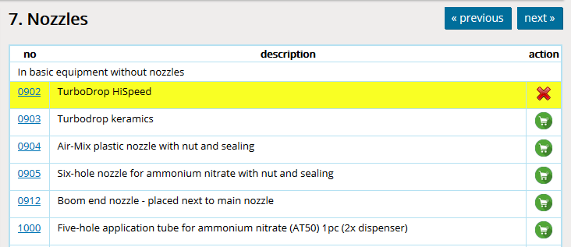
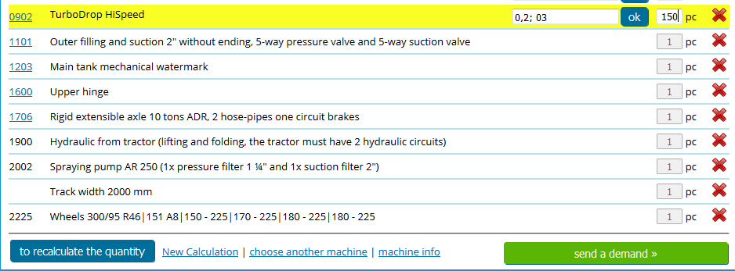
7. Nozzles
After choosing the nozzle don't forget in cart add the size, amount and click the „recalculate the quantity“ button.

Slide 18
8. Topline
Selection of items from the Topline equipment.

Slide 19
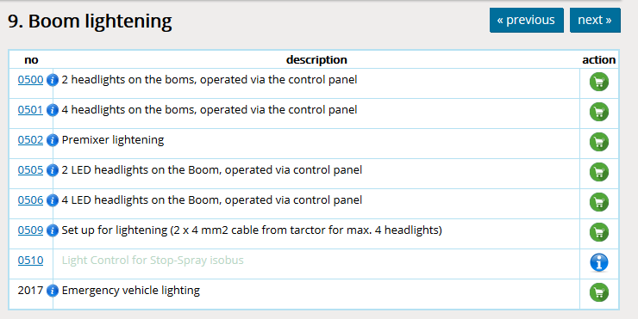
9. Booms lighting
Selection of booms lighting, ecomixer and prepare of lighting.
If the 0227 item is chosen (Stop-spray with ISOBUS), is necessary to add the 0510 item!

Slide 20
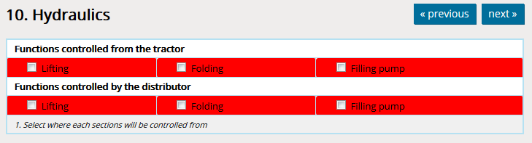
10.1. Hydraulics – how it works
Individual hydraulic functions are automatically marked in hydraulics table according selected equipment.
The table may have up to three levels: Functions controlled from the tractor, Functions controlled via separate hydraulic circuit and Functions controlled via the hydraulic distributor.
Individual functions have preset, from where they will be controlled. If they appear in only one level, is not possible to choose anymore, but when they appear in more levels, is possible to choose.
The first step is to choose, where will be hydraulic functions controlled from.

Slide 21
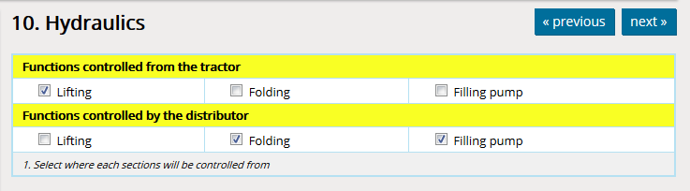
10.2. Hydraulics – functions selection
The first step is to choose, where will be hydraulic functions controlled from.
Functions, which are only once in the table, e.g. Steerable axle, are directly marked, because there is not possibility of selection.
Among the functions that are in the table twice, you must choose one of the options from which to control it. If you choose by mistake both possibilities, boxes turn red.

Slide 22
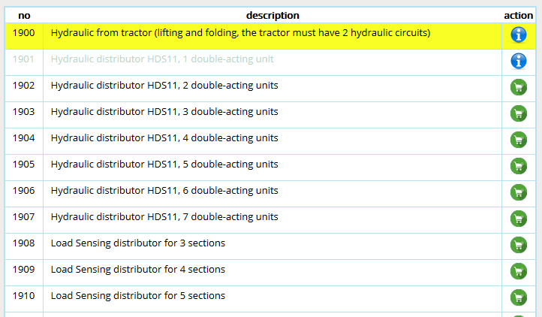
10.3. Hydraulics – distributor selection
After finishing of selection in hydraulics table is possible to choose between distributors.
According the selection, the first possible distributor is the three-sectional one, it means that could be chosen the distributor of from 3 up to 7 sections.
According the selection, the first possible Load Sensing distributor is the four-sectional one, it means that could be chosen the distributor of from 4 up to 8 sections.

Slide 23
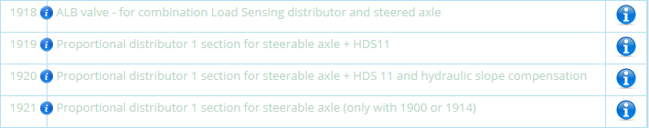
10.4. Hydraulics – selection of distributor for steering axle
If the steerable axle is on the machine + HDS11 distributor, is necessary also to add one of proportional distributors: 1919, 1920 or 1921.
If the steerable axle is on the machine + Load Sensing distributor, it has to be chosen load valve 1918.

Slide 24
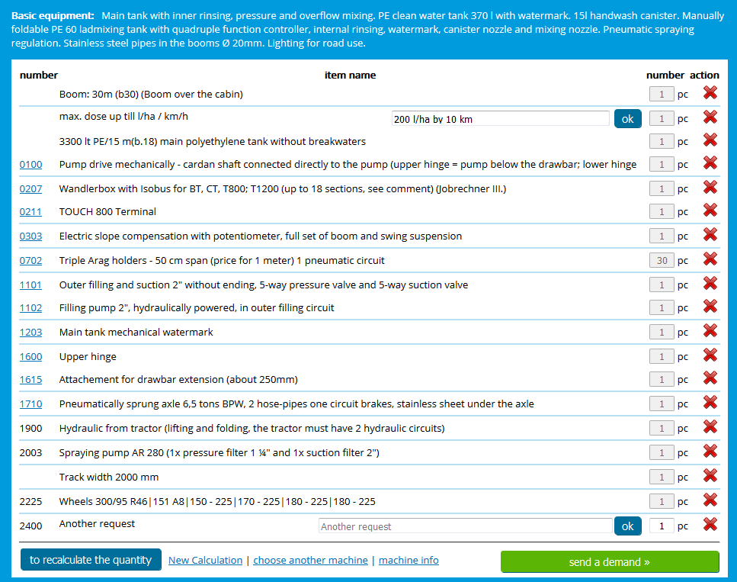
11. Another requests and arrangements
At first add to the cart.
Then write the requirement. If you know the price, write it to the text of requirement.
After we check, if the requirement is possible, we calculate the price and add it to the cart.

Slide 25
12. Transport
For ALKA, NAPA, MAMUT, MAMUT XL, TIGER is sufficient only to add required country to the cart.
For GIGANT and DINO, transport costs are calculated from the price of 1 km + transport charge.

